Slide 1
June 11th REU Lunch Talk: Advice + gnuplot
Dr. Genevieve Bartlett

Slide 2
<Advice>
Get a strong foundation before you specialize
Learn how to learn
Find ways to expand your skills
(both in school and outside of school)

Slide 3
Strong Foundation
Push yourself to take the harder classes
Ask questions (always!)
Grades matter – but focus on what you learn from class and the grades will follow

Slide 4
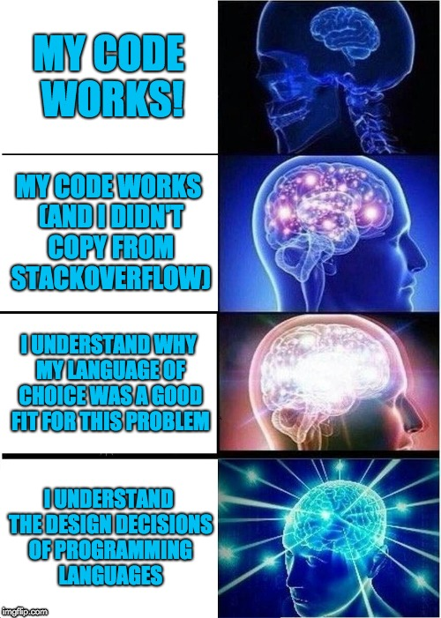
Learn How To Learn

Slide 5
Expand your skills
Hobby projects
Build your own computer
Run your own Web, DNS, email servers
Local opportunities and competitions
Capture the flag competitions
Freelance programming
Get the most you can from school assignments

Slide 6
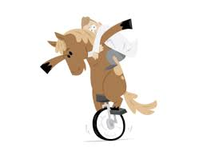
Balance Expanding Your Skills
Depth Breadth
One trick pony
Jack of all Trades
Master of None

Slide 7
Expand your skills on assignments
Write papers in LaTeX
Add extra error checking and handling in code
Use Vim/Emacs etc. and not an IDE
IDEs hide details you should be sure you know!

Slide 8
Hobby Projects
Have an itch and can’t find anything to scratch it?
Itch = start up idea (so says my successful friend)
Itch = at least a learning experience

Slide 9
Hobby Project Examples: My Itch
Stop telling my sister she looks like Angelina Jolie!
Get off my lawn! (Tracking people hanging out in the alley behind my house)

Slide 10
Hobby Project Examples: My Scratch
My sister != Angelina Jolie
Except if she’s angry?
Facial geometry extraction and similarity matching
Focus on non-neutral faces
Turned into semi-functional iOS app (sorta)
Get off my lawn!
TensorFlow! (Retraining with YOLO&darkflow)

Slide 11
Waaay back when (‘08?)

Slide 12
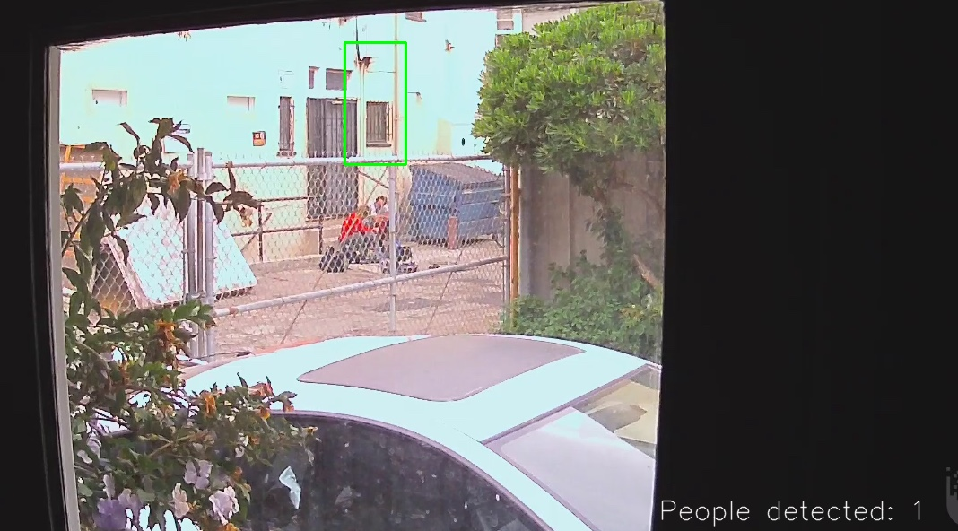
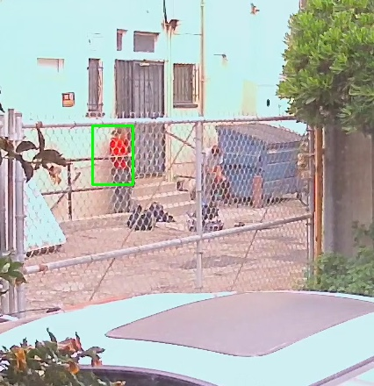
Recently

Slide 13
It’s ok to jump into the deep end
In the context of learning CS at least – you won’t drown
Figure out how you learn
Learn by reading? Tackle a paper or book where >50% does not make sense at first.
Learn by doing? Start playing and modifying someone else’s tools in an area where you’re confused

Slide 14
For those considering it: Do you want a Ph.D.?
No one can answer for you, but realize:
You have to really want it
It’s a commitment
More school != more money
Statistically, MS is a bigger pay bump than PhD
More acceptable these days (IMO) to try something else before school
Explore other options if you’re on the fence!

Slide 15
</Advice>

Slide 16
Quick and Dirty Tutorial
Gnuplot
Open source, widely used in academia, highly scriptable plot generator
http://www.gnuplot.info/

Slide 17
Why gnuplot?
Lots of plotting tools (Excel, plot tools within other tools like matlab, online tools)
Gnuplot is a nice way to unify data and craft a single look for a paper, poster etc.
Easy – just need your data in a text file.

Slide 18
Getting Gnuplot
Windows: binaries available
Linux: any package manager, binaries available
Mac: homebrew, macports, binaries available etc.

Slide 19
Interactive & Scriptable
Gnuplot has an interactive interface (if you want it)…but typically you will not use this interface to generate data to plot (though you can!)

Slide 20
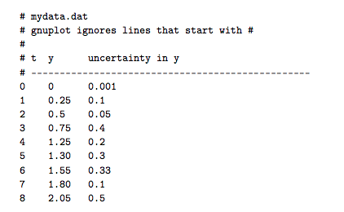
Data Prep
Text file data (# are comments, ignored by gnuplot)

Slide 21
Interactive gnuplot
Start gnuplot from the commandline
You will get an interactive prompt:

Slide 22
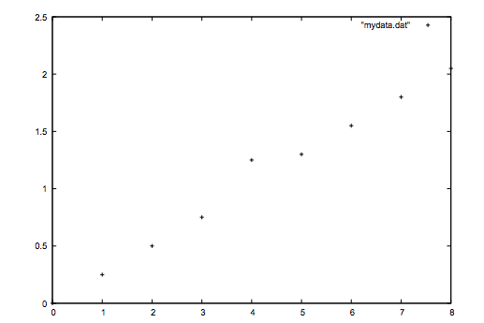
Interactive gnuplot: plot data
Use the “plot” command
Assuming you have access to a GUI screen, the above will produce a nice, but boring plot.

Slide 23
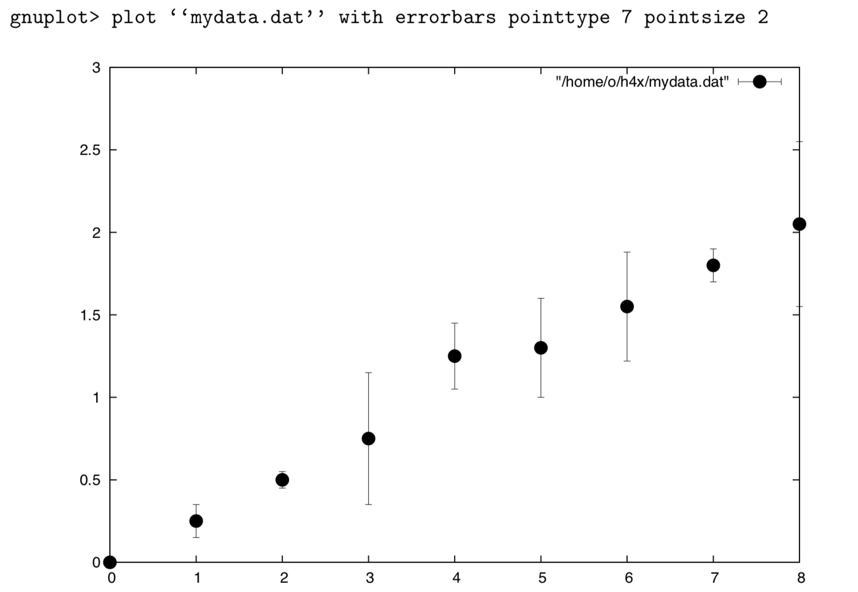
Get a fancy with the plot command

Slide 24
Beautifying the graph
'set’ command can control an awful lot
Output (set term png)
Grid, tic marks, tic mark locations
Yrange and xrange
Aspect ratio
Key location and look
Style (line width, color, look, point size, shape etc.)

Slide 25
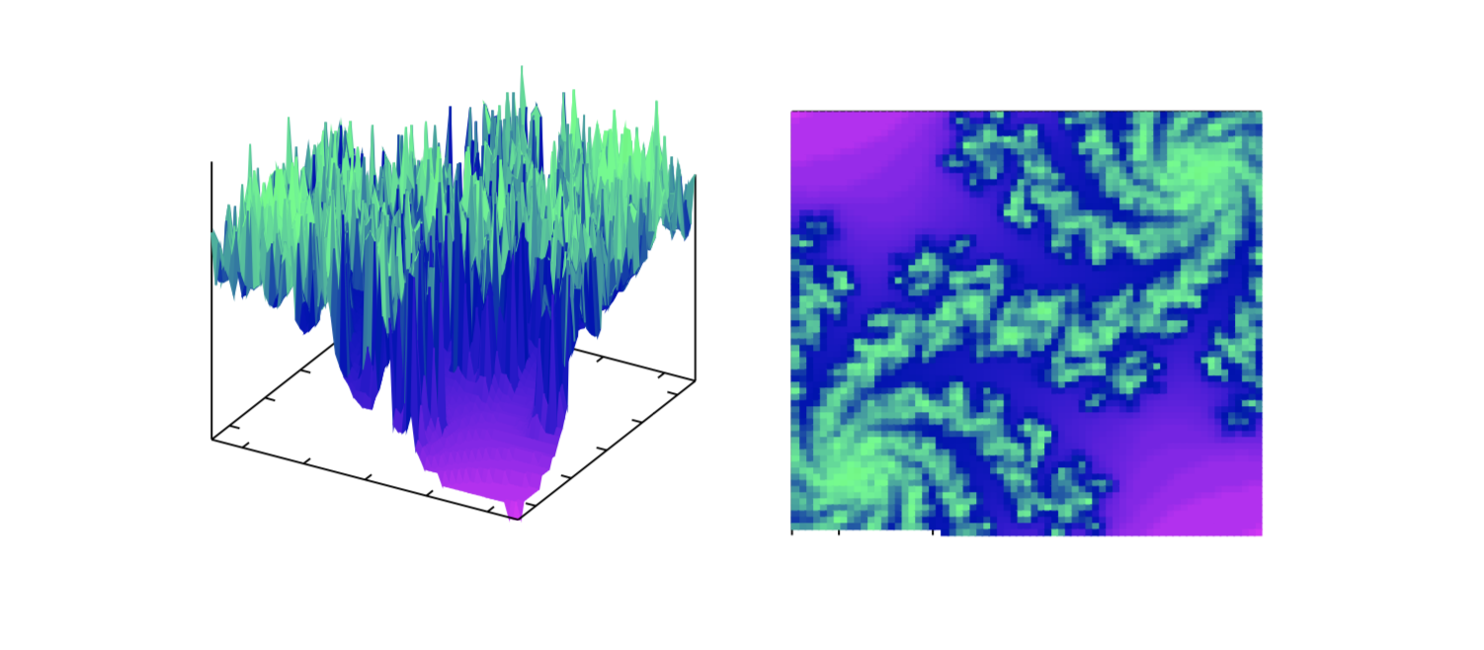
Can get fancy

Slide 26
Interactive->Scripting
Try things out! Get things looking how you like
Then script it!
Feed the gnuplot script to gnuplot
OR – put it inline in shell scripting (allows variables controlled outside of gnuplot)

Slide 27
Brief! Lots to explore
Keep gnuplto in mind - might be the right tool for the job
Lots of good online tutorials – no need to learn everything ahead of time, just know what gnuplot can do for you.

Slide 28
Summary
Get the most you can out of what you’re learning and what you’re doing
Get a basic set of tools you know and like
gnuplot/latex for me, but you may like others
Ask around and see what other people like

